Slide 1
HEALTHCARE MANTRAS
Made by:
V.C.Vishal (15CSU250)
Varun Ahuja (15CSU254)

Slide 2
INTRODUCTION TO HTML AND PHP
The Html and php is a safe type environment for Application development and code execution. It full fill all the aspect of program execution.
A set of software routines that provide a foundation structure for an application.
To provide a consistent object-oriented programming environment.

Slide 3
FRONT END AND BACK END OF THE PROJECT
Front end: HTML, CSS, JS, BOOTSTRAP
Back end: PHP & MYSQL

Slide 4
FRONT END
Hypertext Markup Language (HTML) is the standard markup language for creating web pages and web applications. With Cascading Style Sheets (CSS) and JavaScript it forms a triad of cornerstone technologies for the World Wide Web.
Everything you see in a website is a result of the combination of HTML and CSS. With these two languages, you will have the skills you need to bring your website design to life.

Slide 5
BACK END
PHP is a server-side scripting language designed primarily for web development but also used as a general-purpose programming language
PHP code may be embedded into HTML or HTML5 markup or it can be used in combination with various web template systems, web content management systems and web frameworks.

Slide 6
PROJECT DESCRIPTION
Healthcare Mantras is a website for online medical help. It provides you the list of best hospitals in Delhi and NCR region, so that you can choose the best according to your need. It provides a best and easy way in which a patient can make appointments with doctors. Our main motto is to reduce the efforts of the patients.

Slide 7
REQUIREMENTS
Interface Required- Platform Used:- Win Xp Or Higher Version
Language Used: - PHP, HTML, CSS, MYSQL, JS
Database Used: -MYSQL
Software Used: -Notepad++,Wamp Server Hardware Required- Processor: -456 Mhz Or Above
Ram:- 128 Mb And Above

Slide 8

HOME PAGE

Slide 9
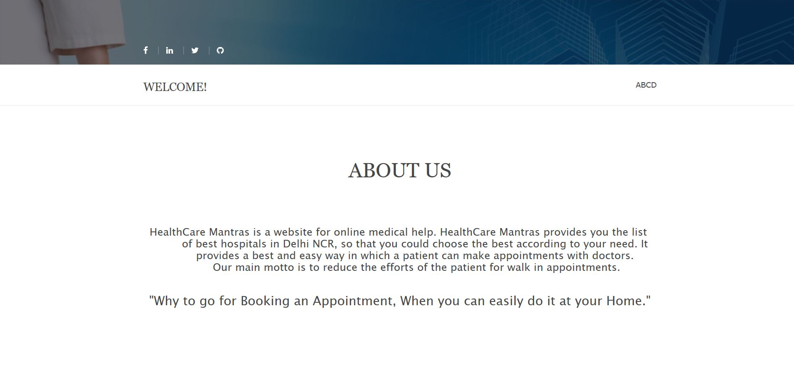
ABOUT

Slide 10
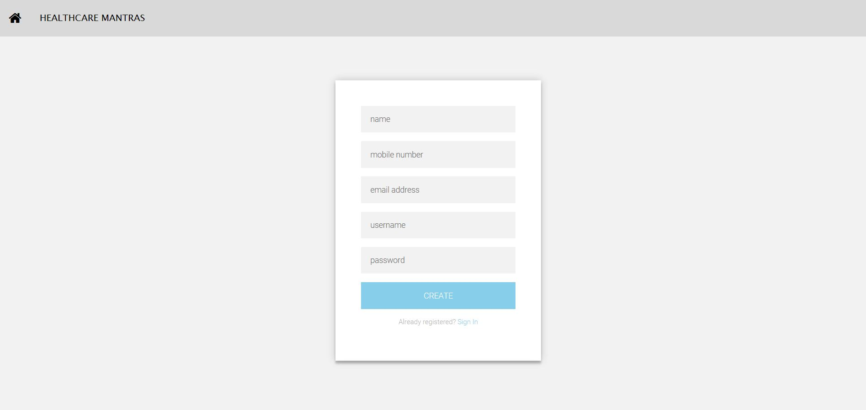
SIGNUP PAGE

Slide 11
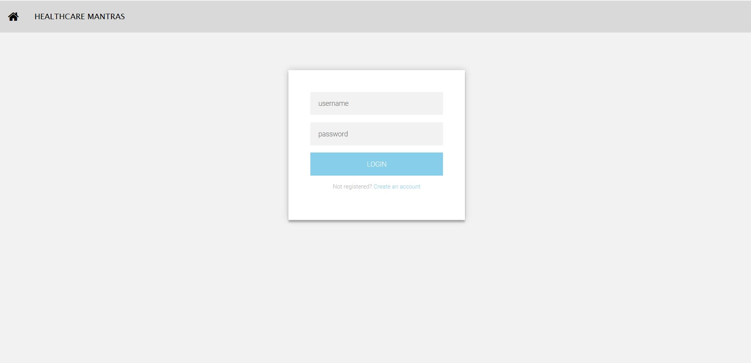
LOGIN PAGE

Slide 12
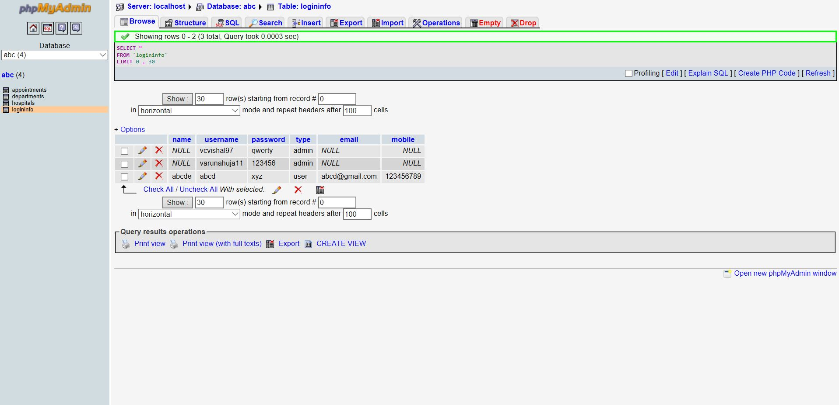
LOGIN DETAILS IN DATABASE

Slide 13
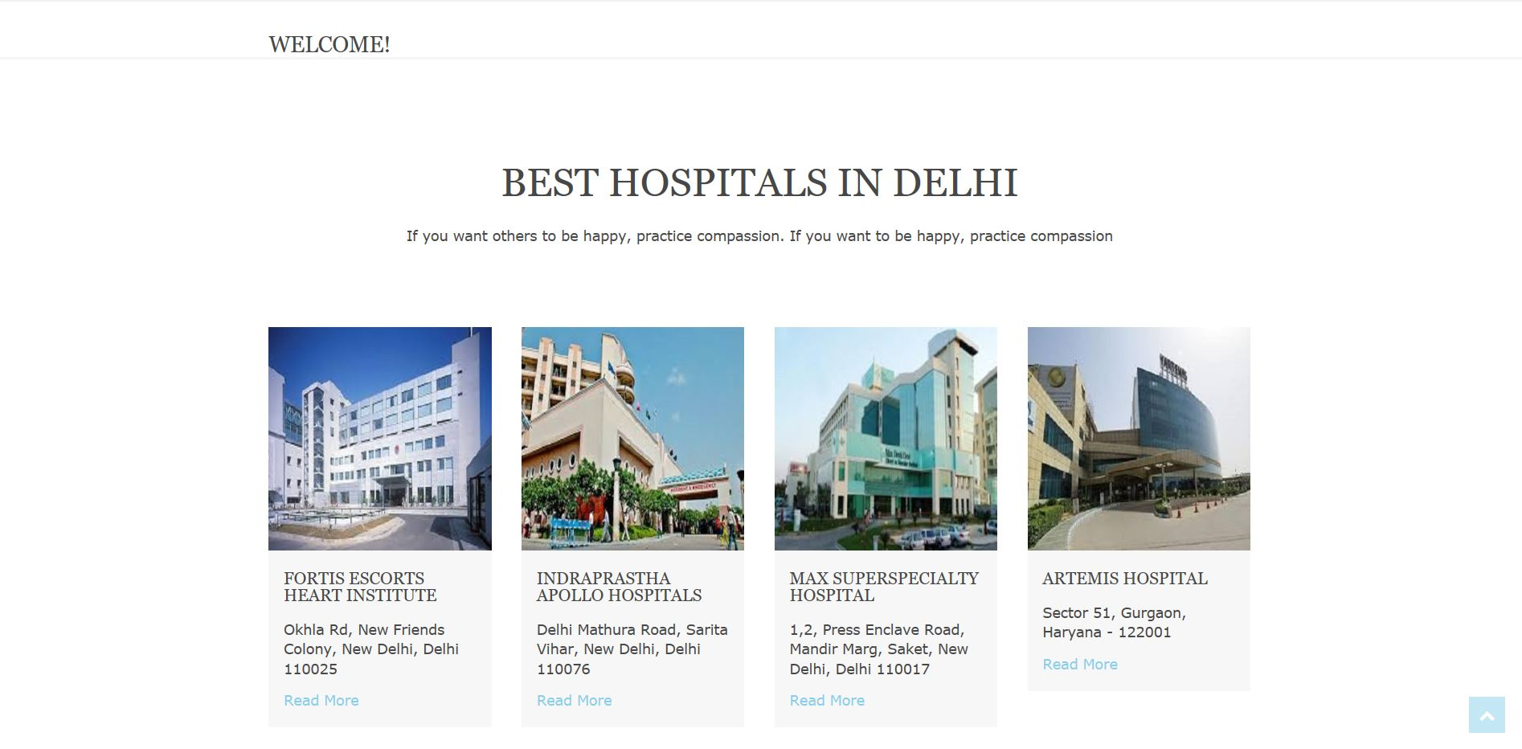

Slide 14
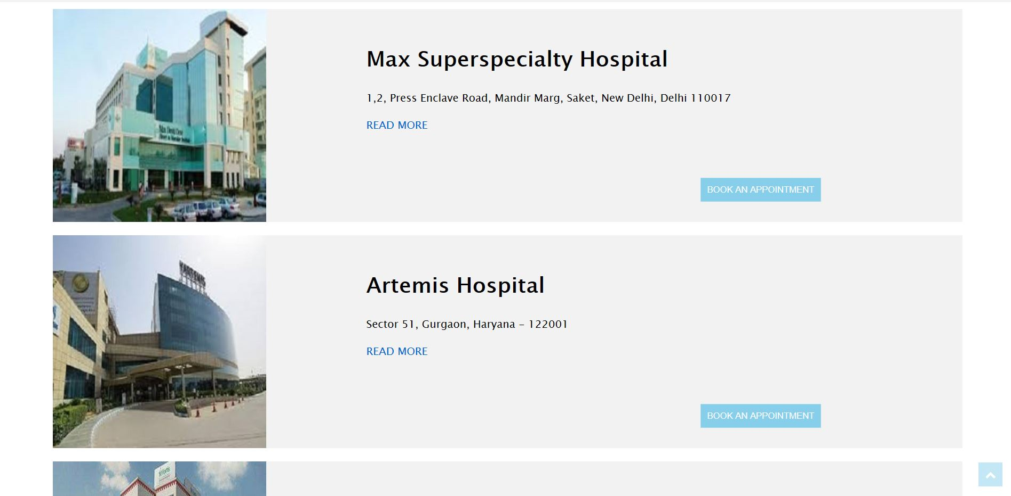
LIST OF MORE HOSPITALS

Slide 15
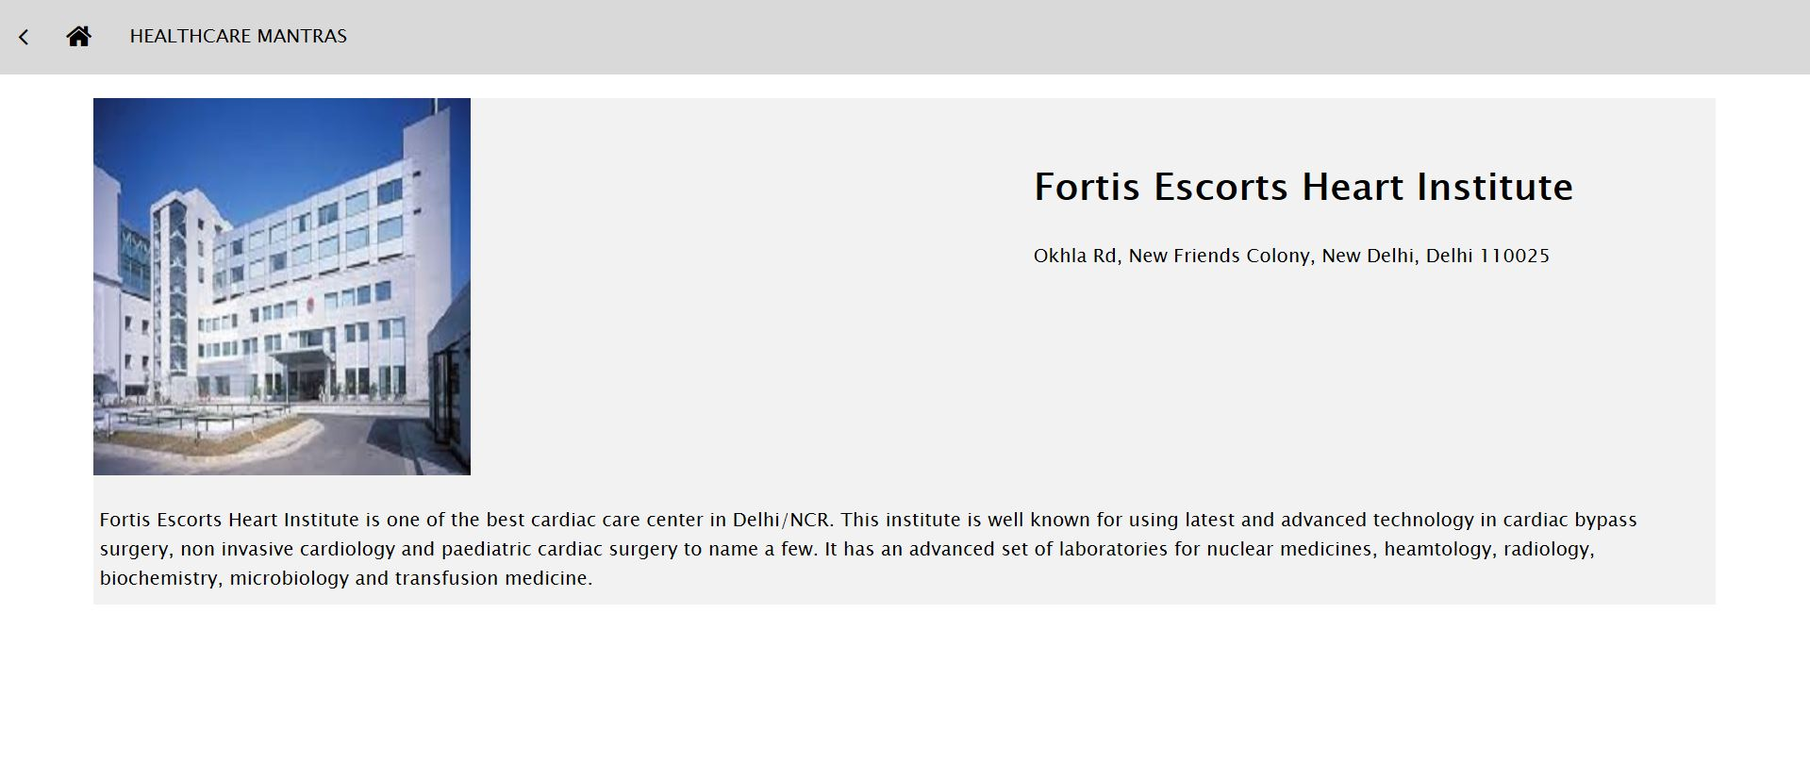
ABOUT ANY HOSPITAL

Slide 16
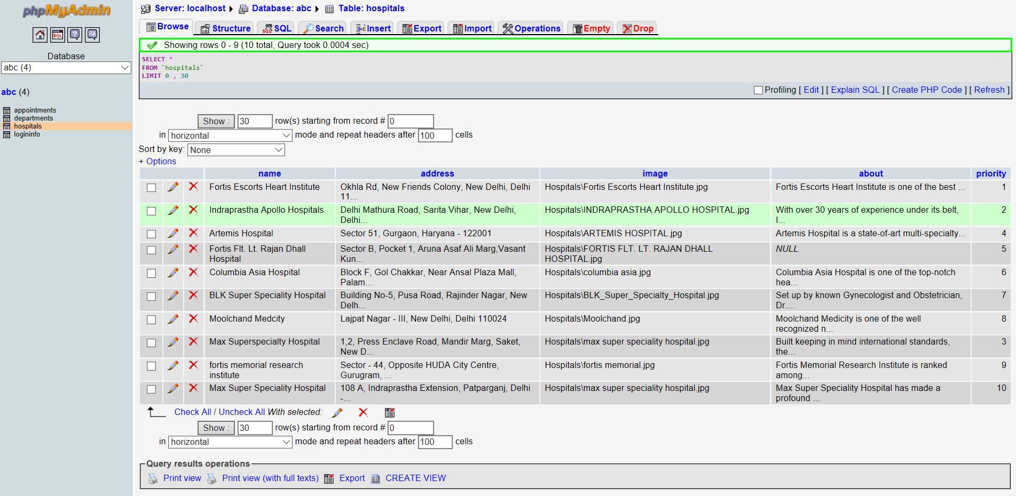
HOSPITALS IN THE DATABASE

Slide 17
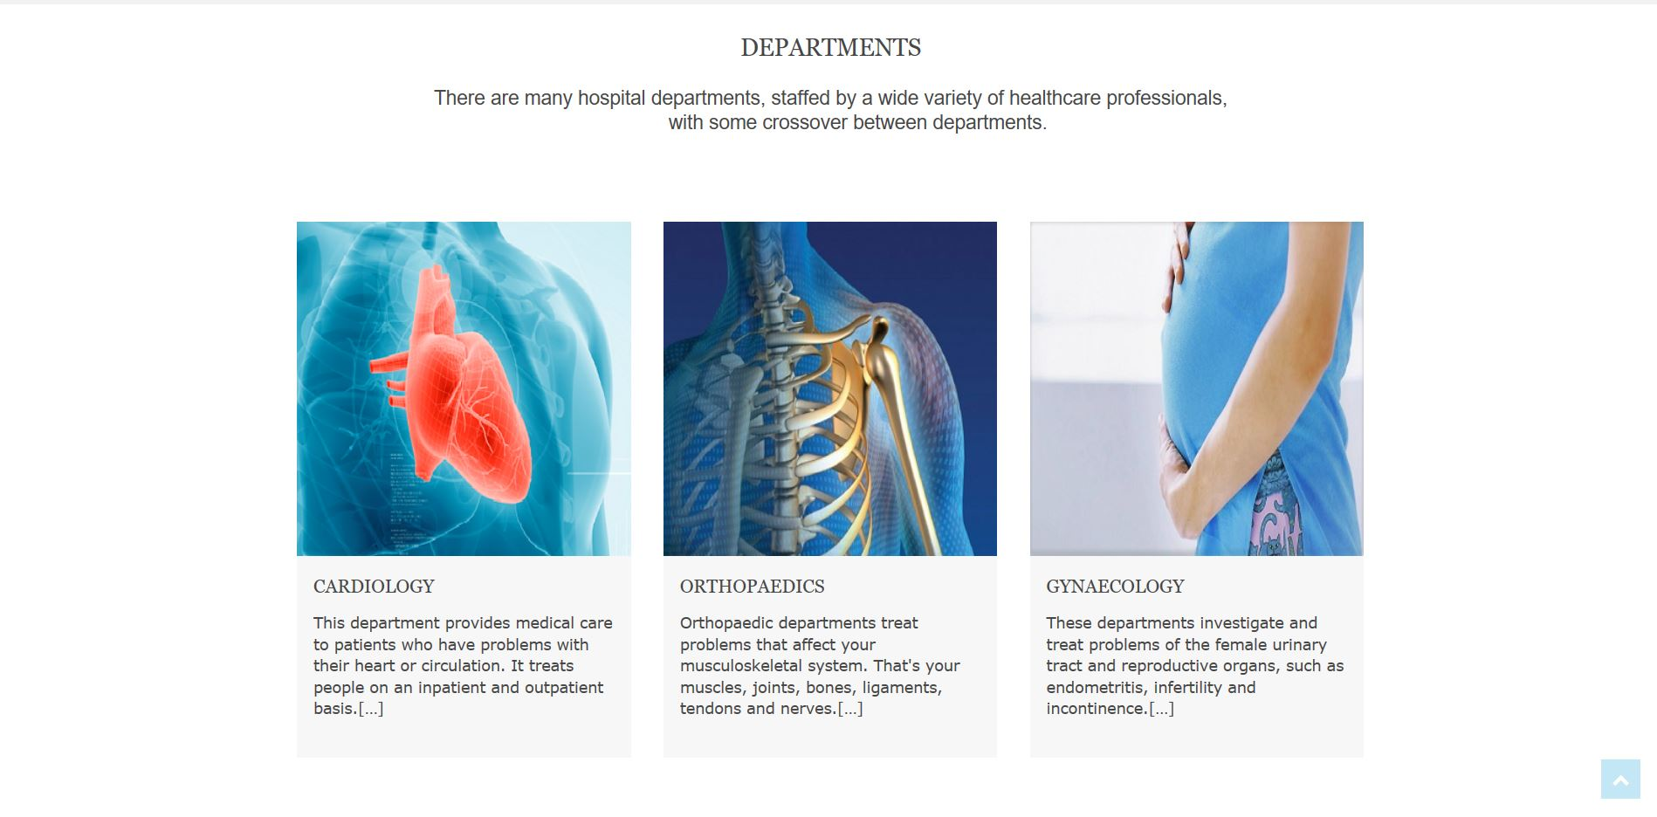

Slide 18
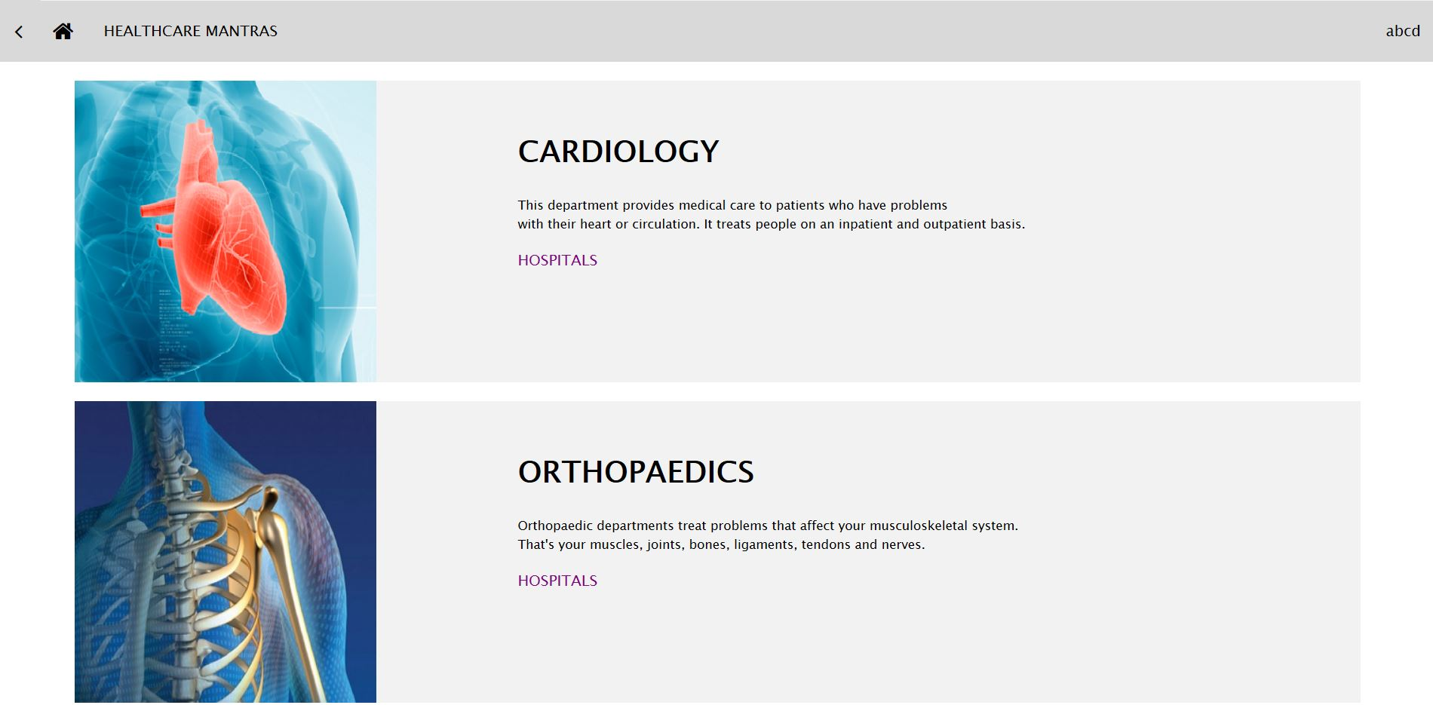
DEPARTMENTS

Slide 19
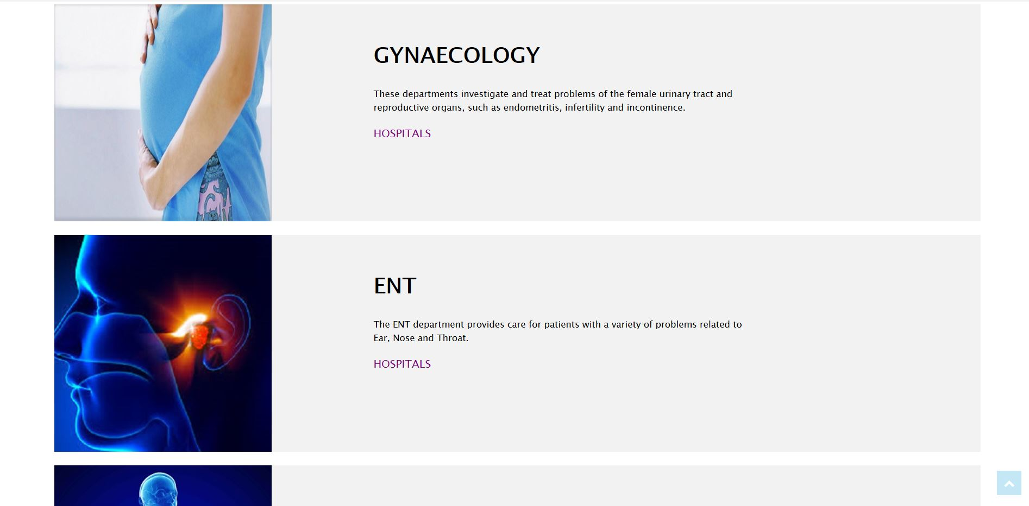

Slide 20
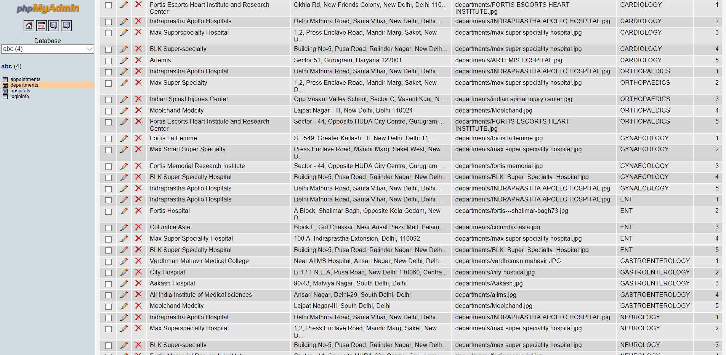
HOSPITALS & DEPARTMENTS IN THE DATABASE

Slide 21
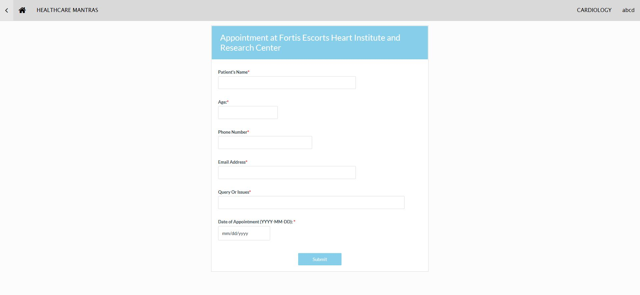
PATIENT REGISTRATION FORM

Slide 22
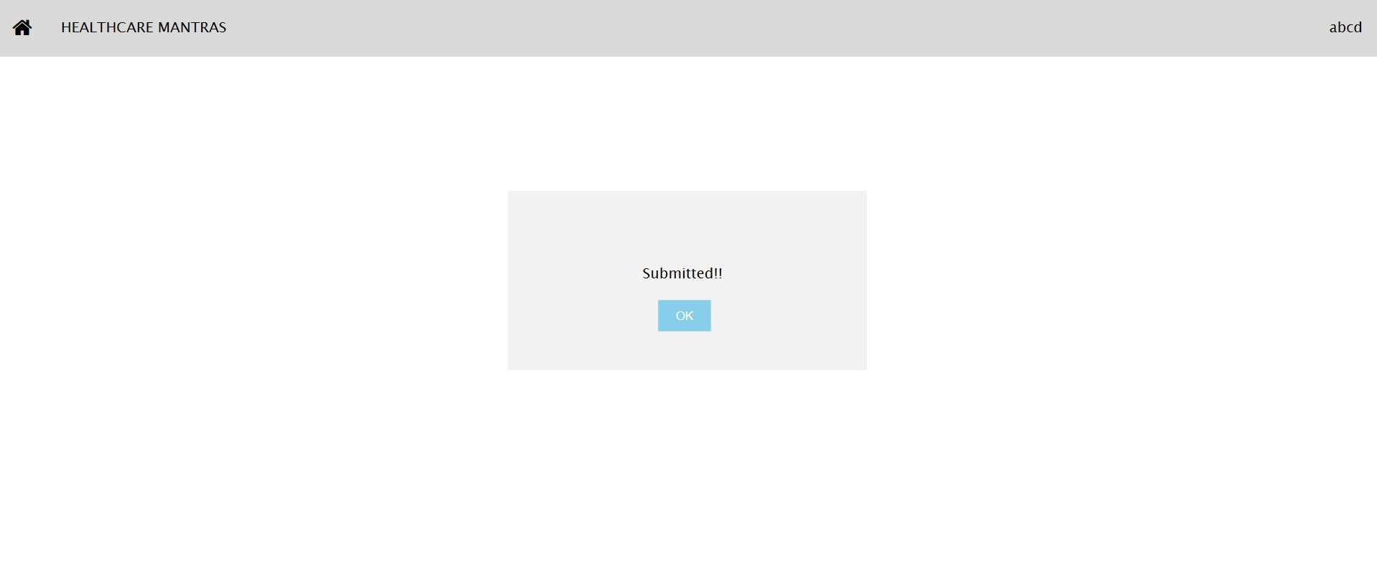

Slide 23
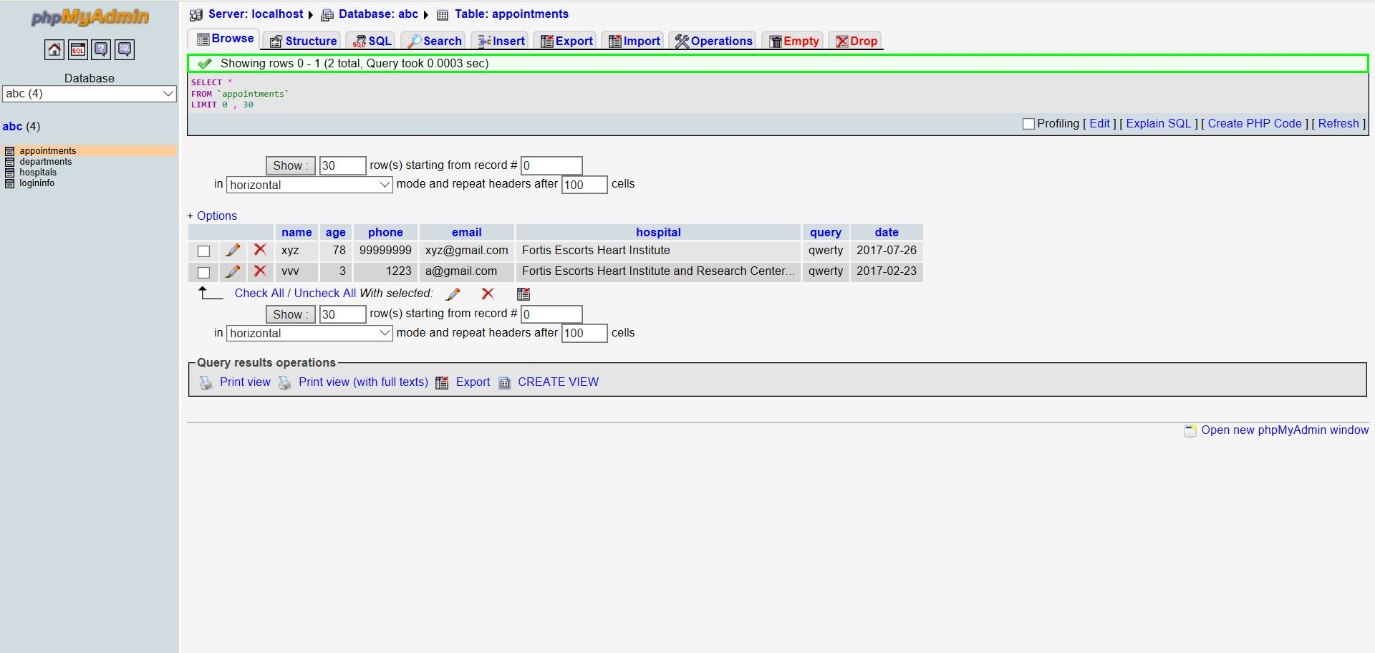
APPOINTMENTS IN THE DATABASE

Slide 24
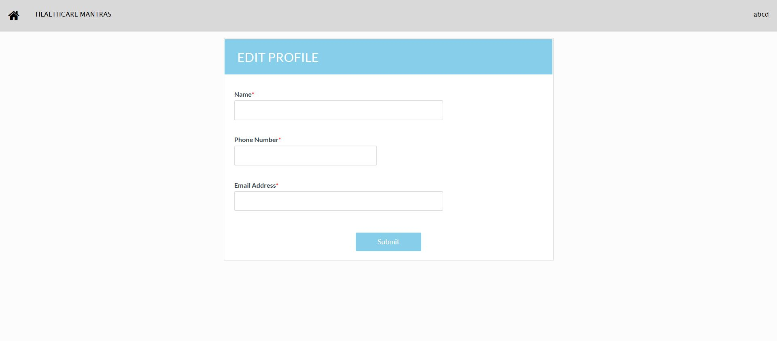
EDIT PROFILE

Slide 25

ADMIN PAGE

Slide 26


Slide 27
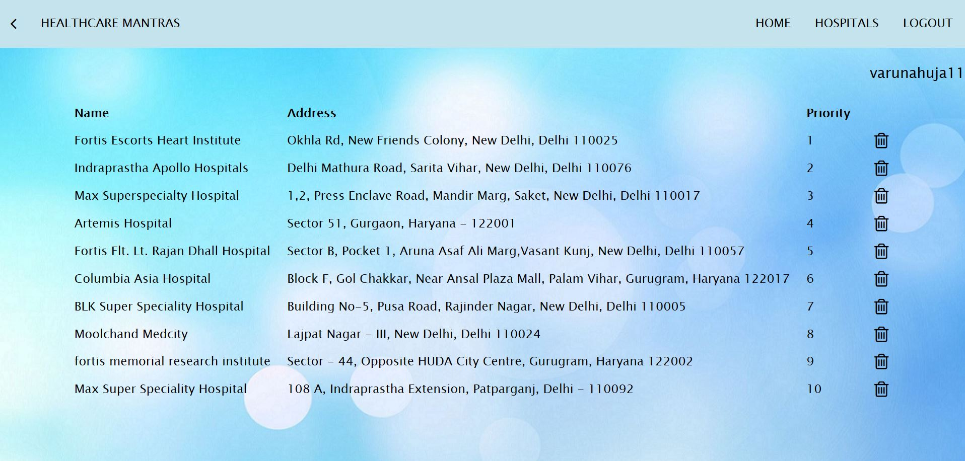
LIST OF HOSPITALS IN ADMIN PAGE

Slide 28
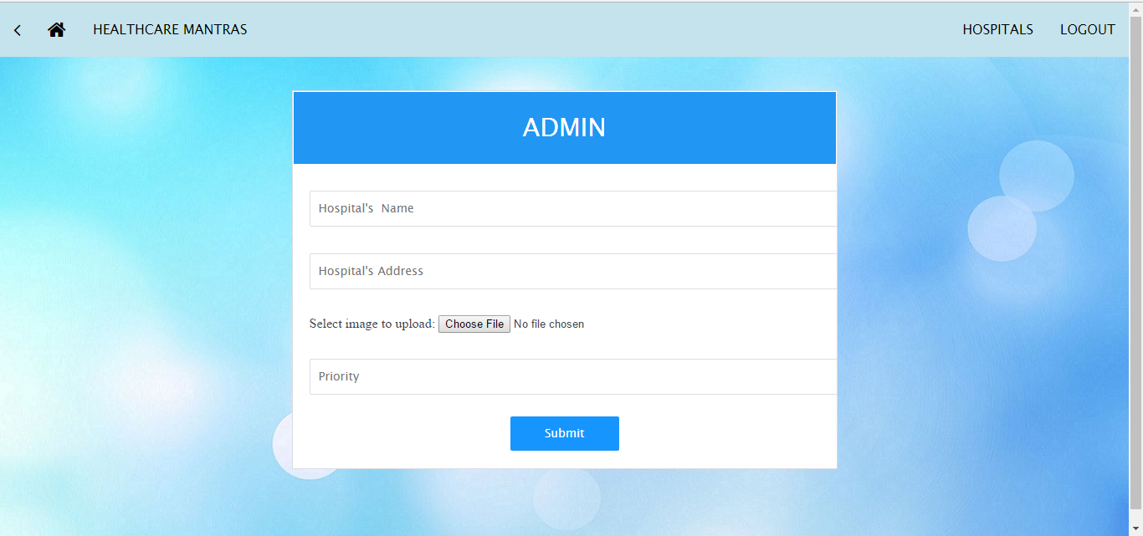
ADDING HOSPITALS

Slide 29
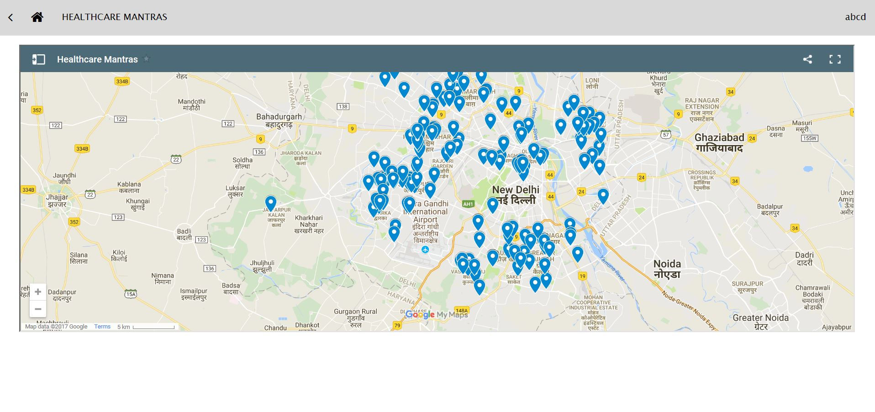
MAP

Slide 30
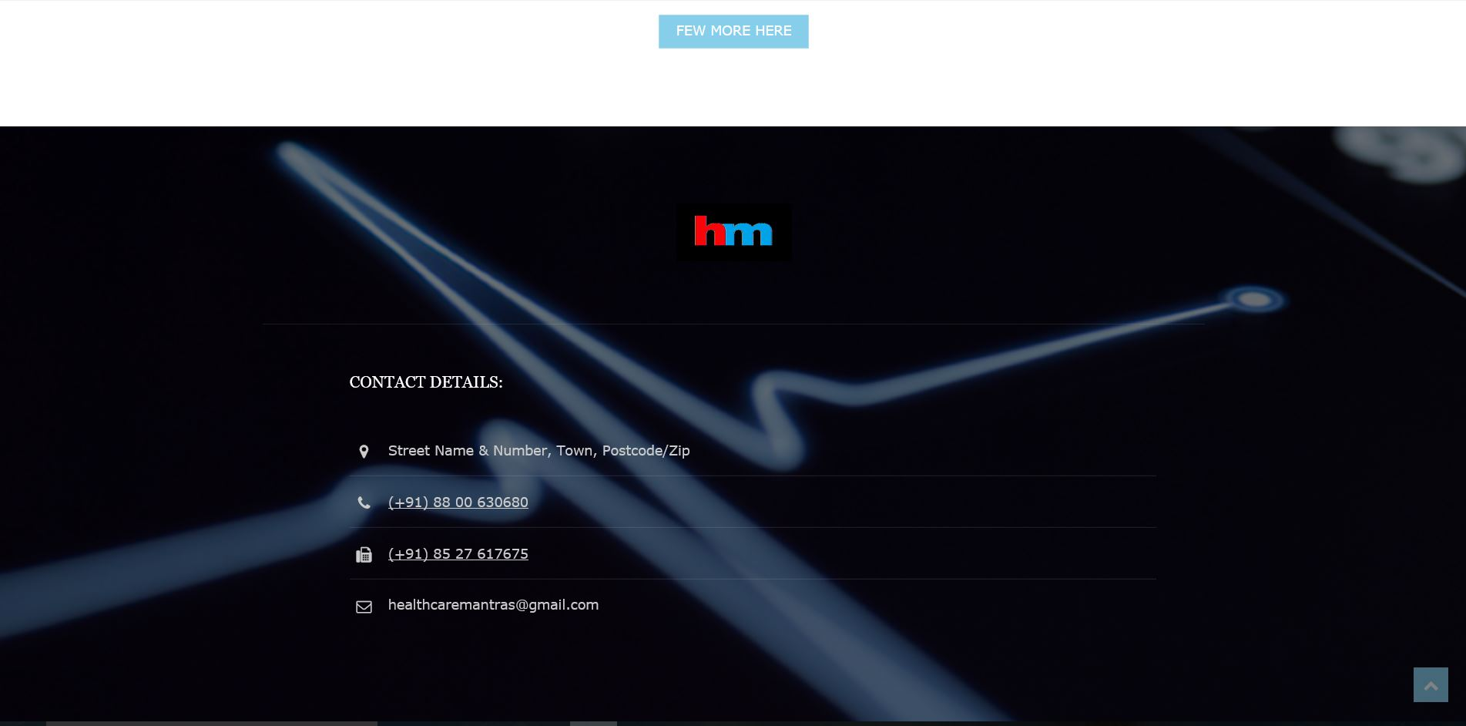
CONTACT

Slide 31
CONCLUSION
We have successfully completed the project “Healthcare Mantras”. With help of various links and tools we have been able to provide an easy interface for the people who visit here. Although some more improvements are needed. I hope this will go a long way and further some further updates this website will definitely become more usefull and efficient.

Slide 32
THANK YOU

